Slide 1




V.A.L.O.R. – Vision-based Autonomous Location and Obstacle-avoidance Robot
Syed Mubeen Ali 1604-21-735-087
Danish Ahmed 1604-21-735-097
Syed Zeeshan Ali 1604-21-735-098
Batch No. B14
Date: 02/01/25
Guide: Mrs. B. Sucharitha

Slide 2



Presentation Outline
1. Introduction
2. Applications
3. Problem Statement
4. Literature Survey
5. Objectives
6. Methodology
7. Design Specifications
8. Block Diagrams
9. Timeline
10. References

Slide 3
INTRODUCTION
Automation is transforming industries by replacing manual processes with intelligent, efficient systems.
In transportation, it enables vehicles to navigate independently, improving safety and reducing congestion.
Self-driving technologies aim to deliver sustainable and adaptive mobility solutions.
The focus is on creating reliable systems for diverse real-world scenarios.
These advancements reflect a shift towards smarter, more efficient transportation networks.

Slide 4
INTRODUCTION
Computer vision allows machines to interpret and analyze visual data.
It uses deep learning to detect objects, lanes, and obstacles in real time.
This project applies computer vision to develop a scalable, autonomous vehicle prototype.
Such systems are integral to bridging the gap between theoretical AI models and practical, real-world applications.

Slide 5
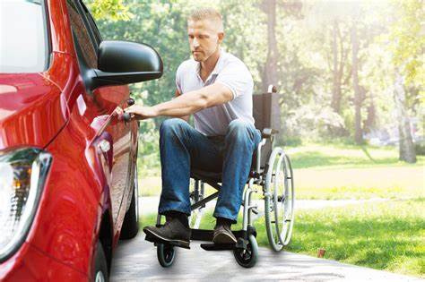
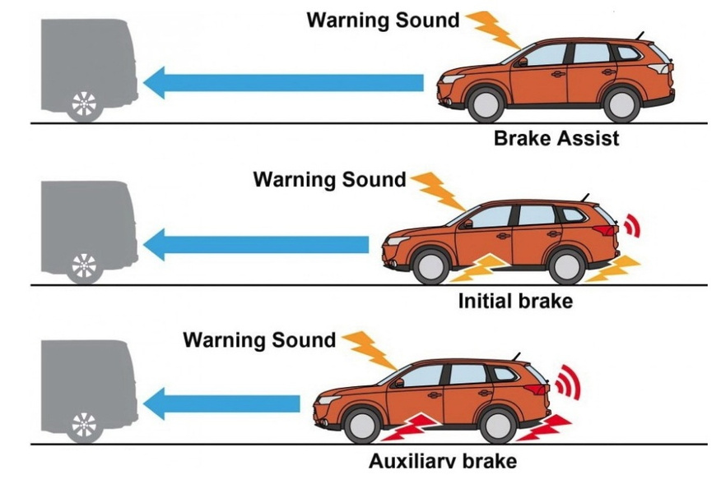
APPLICATIONS
Mobility solutions for people with disabilities or elderly individuals.
Accident prevention through real-time object detection and obstacle avoidance.

Slide 6
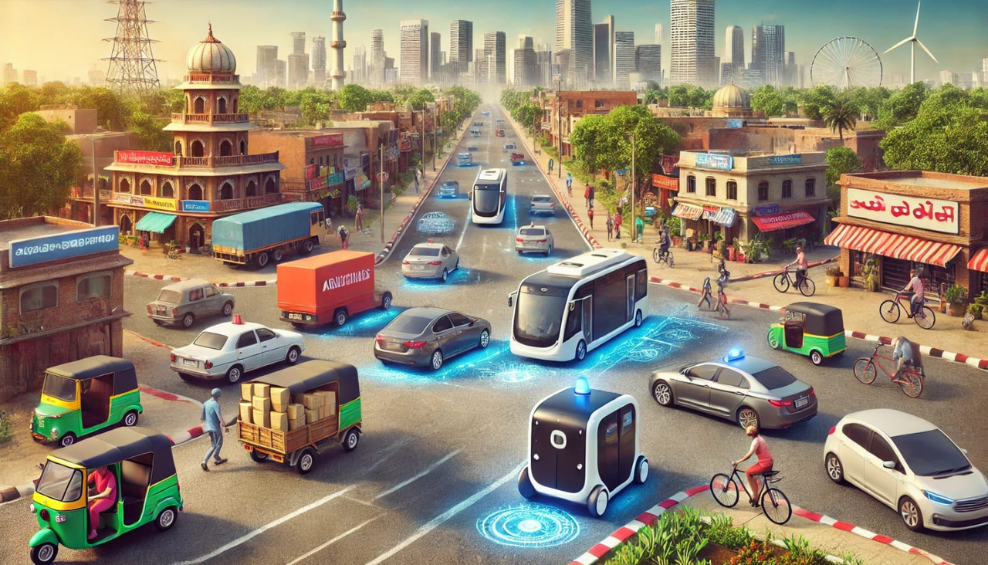
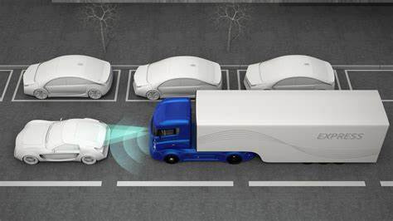
APPLICATIONS
Development of driverless buses and shuttles for safe and efficient urban commuting.
Autonomous logistics and operation trucks for long-haul transportation.

Slide 7
PROBLEM STATEMENT
Indian roads are characterized by poor lane markings, frequent potholes, and unpredictable traffic behavior, creating significant challenges for autonomous vehicles.
The absence of clear lane boundaries, damaged road surfaces, and erratic movements from vehicles and pedestrians complicate safe navigation.

Slide 8
LITERATURE SURVEY
S. No | Title | Author | Year | Paper Description
1 | Design and Development of Autonomous Driving Car Using Nvidia Jetson Nano Developer Kit | Manjunath R Kounte, Harshvardhan VS, Dhruv S , Aswini Shri C V , Ayushi Kumari | 2022 | The project develops a low-cost autonomous car using NVIDIA Jetson Nano, integrating AI, machine learning, and neural networks. It achieves real-time navigation and object detection, with future plans for traffic sign recognition and vehicle-to-vehicle communication (V2V).
2 | Aspects of Autonomous Drive Control Using NVIDIA Jetson Nano Microcomputer | Kacper Podbucki, Tomasz Marciniak | 2022 | The study demonstrates autonomous driving using a Waveshare JetRacer AI vehicle with NVIDIA Jetson Nano, ResNet18 neural network, and IMX219 camera. Optimized training achieved precise navigation, showcasing embedded systems’ potential for efficient, real-time, AI-driven vehicle control.
Notes:
3. "Design and Development of Autonomous Driving Car Using Nvidia Jetson Nano Developer Kit"
●
Summary: This paper presents the design of a self-driving car model using the Jetracer AI framework and the NVIDIA Jetson Nano Developer Kit. It uses AI and ML frameworks like PyTorch and OpenCV. The paper also discusses a lane detection model using Python for image processing, including techniques like RGB to HSV conversion, Gaussian blur, grayscale conversion, Canny edge detection, and Hough transform.
●
Strengths:
○
Practical implementation: The paper provides a hands-on approach to designing a self-driving car.
○
Specific hardware focus: It makes use of a readily available and affordable platform.
○
Specific examples: It describes the process of lane detection in detail with commonly used image processing techniques.
●
Weaknesses:
○
Limited scope: The paper focuses mainly on lane detection, with a lack of detail regarding other functionalities of autonomous driving.
○
Basic techniques: It uses basic image processing techniques, which might not be as robust as deep learning methods.
○
Lack of Evaluation: There is no evaluation of the lane detection performance mentioned in the text.
2. "Aspects of Autonomous Drive Control Using NVIDIA Jetson Nano Microcomputer"
●
Summary: This paper focuses on the use of backpropagation and the Adam algorithm to optimize a network model for autonomous driving using a NVIDIA Jetson Nano microcomputer. It also discusses converting a PyTorch model to a TensorRT model to optimize performance. The model uses a dataset of 600 frames, divided into 80% for training and 20% for validation.
●
Strengths:
○
Focus on optimization: The paper emphasizes practical optimization techniques for running deep learning models on resource-constrained hardware.
○
Specific Hardware: It targets a very specific and commonly used platform.
●
Weaknesses:
○
Limited scope: The paper's focus is limited to the optimization of a specific model, lacking broader discussion on other aspects of autonomous driving.
○
Small dataset: The use of only 600 frames might limit the model's generalizability and robustness.
○
Lack of context: It doesn't provide much detail on the type of autonomous driving task it addresses.

Slide 9
LITERATURE SURVEY
S. No | Title | Author | Year | Paper Description
3 | Developments in Image Processing Using Deep Learning and Reinforcement Learning | Jorge Valente, João António, Carlos Mora, Sandra Jardim | 2023 | The paper reviews advancements in image processing using deep learning and reinforcement learning, highlighting applications like medical imaging and autonomous driving, challenges like high data demands, and future goals of enhancing efficiency, scalability, and ethical transparency.
4 | YOLO-Based Object Detection and Tracking for Autonomous Vehicles Using Edge Devices | Pedro Azevedo, Vitor M.F. Santos | 2022 | The paper evaluates YOLO-based object detection and tracking on NVIDIA Jetson AGX Xavier for real-time autonomous driving. YOLOR-CSP with DeepSORT offers optimal accuracy and speed, achieving 33 FPS, while addressing challenges like imbalanced datasets and varying urban conditions.
Notes:
4. "Developments in Image Processing Using Deep Learning and Reinforcement Learning"
●
Summary: This paper reviews recent advances in AI, particularly deep learning (DL) and reinforcement learning (RL), for image processing. It discusses challenges, applications, and future research directions. The paper explores the use of ML techniques in different areas, noting a lack of studies that highlight these techniques outside of medical imaging. It covers technical aspects of AI models, image processing, and various machine learning concepts.
●
Strengths:
○
Broad overview: It provides a comprehensive review of AI models used in image processing, including both DL and RL.
○
Focus on trends: The paper analyses the evolution of research in this field and highlights the increase in publications using deep learning for image processing.
○
Future directions: It highlights current challenges and proposes possible future research areas.
●
Weaknesses:
○
Generalised approach: Due to its wide scope, the paper provides a general overview without delving deep into specific applications or techniques.
○
Limited practical focus: The review is more theoretical, lacking concrete examples of implementations or case studies beyond brief mentions.
○
Acknowledged limitations: It identifies the limitations of current models, such as the inability to generalize beyond their training context, without providing specific solutions.
6. "YOLOv8 Based Object Detection for Self-driving Cars"
●
Summary: This paper explores object detection and tracking solutions for autonomous driving by comparing different state-of-the-art object detectors like YOLOv5, Scaled-YOLOv4, and YOLOR, trained on the BDD100K dataset. It focuses on the implementation of these algorithms on edge devices, specifically the NVIDIA Jetson AGX Xavier. The paper investigates the use of DeepStream technology for real-time inference and compares different object trackers such as NvDCF and DeepSORT.
●
Strengths:
○
Edge device focus: The paper focuses on the practical deployment of algorithms on edge devices with a focus on low latency, which is a critical factor in real-time systems.
○
Fair comparison: It compares several SOTA object detection algorithms, which provides useful insights into their performance in a real-world context.
○
Real-time tracking evaluation: The use of DeepStream and object trackers offers a comprehensive evaluation of complete real-time systems.
●
Weaknesses:
○
Dataset limitations: The paper uses a sub-sampled version of the BDD100K dataset due to hardware constraints, which might affect the generalization capabilities of the trained models.
○
Specific hardware dependence: Evaluation is tied to the NVIDIA Jetson AGX Xavier, limiting the generalizability of the results to other platforms.
○
Limited tracking classes: The KITTI tracking evaluation is only performed on cars.

Slide 10
LITERATURE SURVEY
S. No | Title | Author | Year | Paper Description
5 | Applications of Computer Vision in Autonomous Vehicles: Methods, Challenges and Future Directions | Xingshuai Dong, Massimiliano Cappuccio | 2023 | This paper reviews computer vision applications in autonomous vehicles, including depth estimation, object detection, lane detection, and traffic sign recognition. It explores the evolution of autonomous driving systems and the sensors and data sets commonly used. The paper also addresses public opinions and concerns, as well as technological challenges and future research directions. The levels of driving automation as defined by the SAE are discussed. The paper concludes with a discussion of future research.
Notes:
1. "Applications of Computer Vision in Autonomous Vehicles: Methods, Challenges and Future Directions"
●
Summary: This paper reviews the use of computer vision in autonomous vehicles (AVs) over the last decade. It explores the evolution of autonomous driving systems, commonly used sensors and datasets, and computer vision applications like depth estimation, object detection, lane detection, and traffic sign recognition. The paper also considers public opinion, technological challenges and future research directions. It aims to provide an understanding of AVs from both academic and industry viewpoints.
●
Strengths:
○
Comprehensive overview: The paper provides a broad look at various aspects of computer vision in autonomous driving.
○
Structured approach: It's organized logically, covering the development of AV systems, sensors, datasets, applications, public opinion, challenges and future directions.
○
Literature review: The paper prioritizes publications from prestigious journals and conferences, offering a good overview of the state-of-the-art.
●
Weaknesses:
○
Not exhaustive: Given the vast amount of research, the paper acknowledges it cannot cover all state-of-the-art papers.
○
Limited scope: The review is focused on publications from 2013 to 2023, potentially missing more recent advancements.
○
Generalised analysis: It doesn't delve into extreme technical detail on specific algorithms or implementations.

Slide 11
OBJECTIVES
The goal is to create an autonomous vehicle prototype using camera inputs for lane detection and obstacle avoidance.
Design the system to navigate a college campus, addressing challenges like unmarked roads and dynamic obstacles.
Showcase a scalable solution tailored for localized transportation needs in Indian road conditions.

Slide 12
DESIGN METHODOLOGY
Data Collection:
Gather real-time data using the camera for detecting poor lane markings and potholes.
Use the camera to capture diverse road conditions and obstacles.
Collect data across different environments to ensure model generalization.
Data Processing:
Apply filters like resizing, normalization, and smoothing to enhance image quality.
Use OpenCV to process raw images for feature extraction.
Prepare data for model input, ensuring consistency and accuracy in training.

Slide 13
DESIGN METHODOLOGY
3. Model Training:
Train the model using CNN architectures such as ResNet or DarkNet.
Optimize the model for detecting lane markings and obstacles.
Experiment with hyperparameters and training techniques to achieve high accuracy.
4. Path Planning:
Use Google Maps API to retrieve accurate navigation routes and directions.
Extract necessary path information, such as turns, speed adjustments, and stops.
Plan the vehicle's route in real-time based on the provided directions.

Slide 14
DESIGN METHODOLOGY
5. Actuation:
Integrate hardware with the software for real-time execution.
Ensure smooth coordination between motor control, steering, and obstacle avoidance.
Implement speed control and turning decisions based on path planning.
6. Testing:
Test the vehicle on different road conditions, including poor lane markings and potholes.
Evaluate the vehicle’s navigation accuracy and obstacle avoidance performance.
Refine the system based on testing results for real-world deployment.

Slide 15
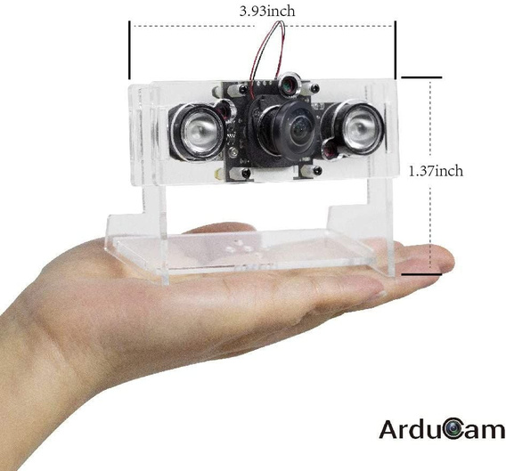
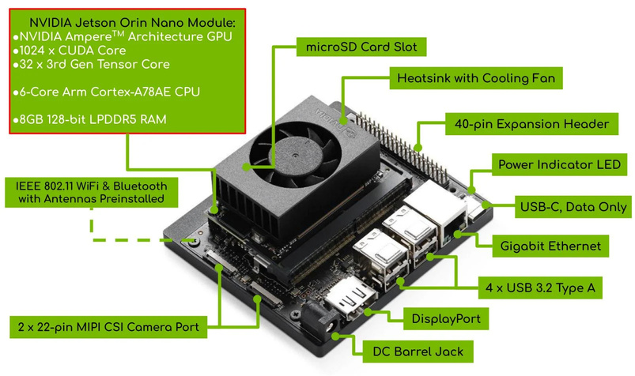
DESIGN SPECIFICATIONS
Component: NVIDIA Jetson Orin Nano .
Purpose: Handles vision-based AI tasks, including image processing and deep learning inference.
Features: 1024 CUDA cores, 8GB LPDDR5 RAM, supports CUDA and TensorRT for optimized AI performance.
Component: Stereo Arducam OV5647 Cameras.
Purpose: Captures stereoscopic images for depth perception, lane detection, and obstacle avoidance.
Features: 5MP resolution, 1080p video recording, CSI interface for efficient data transfer.

Slide 16
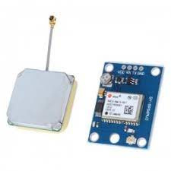
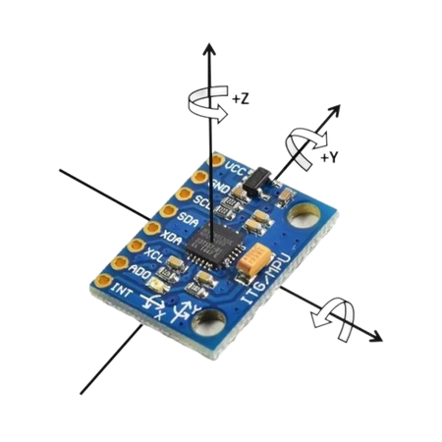
DESIGN SPECIFICATIONS
Component: u-blox NEO-M8N.
Purpose: Provides precise location data for navigation.
Features: Multi-GNSS support (GPS, GLONASS, Galileo), 2.5m horizontal accuracy, up to 10 Hz update rate.
Component: MPU-6050.
Purpose: Tracks angular velocity and acceleration for stability and orientation.
Features: 3-axis accelerometer and gyroscope, I2C interface, onboard Digital Motion Processor (DMP).

Slide 17
FLOWCHART
Image Capture and Pre-processing
Object Detection
Decision Making Module
Obstacle Avoidance
Real-Time Monitoring
Control System

Slide 18
FLOWCHART
Image Capture and Pre-processing
Object Detection
Decision Making Module
Real-time video frames are processed for efficiency and analysis by resizing the resolution to reduce computational load, converting to grayscale to simplify data if color is unnecessary, and normalizing pixel values to a range like 0-1.
Video frames are processed through the YOLO model for real-time object detection. The output includes identified objects, such as pedestrians, vehicles, and potholes, with bounding boxes indicating their positions for further analysis or applications.
Lane detection uses OpenCV for edge identification, pothole detection employs YOLO for real-time pothole recognition. Path planning integrates Google Maps API for directions and YOLO outputs for obstacle detection, with behavior logic adjusting speed and actions accordingly.

Slide 19
FLOWCHART
Obstacle Avoidance
Real-Time Monitoring
Control System
To control motors, send signals for Forward/Reverse movement, Left/Right turns, and adjust speed using Pulse Width Modulation (PWM). PWM controls motor speed by varying the duty cycle, allowing for precise adjustments in velocity.
Continuously monitor the motor's speed, obstacle positions, and navigation progress. Speed is tracked for optimal control, obstacles are detected to avoid collisions, and navigation progress is monitored using GPS or relative positioning for accurate movement.
If an obstacle is detected, the system slows down or stops to prevent a collision. It then recalculates the path by making a small deviation, ensuring safe navigation around the obstacle while maintaining the desired trajectory.

Slide 20
PROJECT TIMELINE
Hardware Assembly
Integration
Gathering all hardware components like GPU, cameras, motors, sensors, etc and then assembling all components into a working machine.
Incorporating all hardware components with the machine learning model to develop a seamless vehicle.
JAN
MAR
DEC
FEB
APR
Literature Survey
Model Training
Testing & Publication
Conducting literature survey of available resources by going through journals, books, repositories, etc.
Collecting datasets and training the model on different architectures and tuning the hyperparameters to create the most optimum model.
Evaluating and testing the vehicle on multiple tracks and under different conditions and adjusting it accordingly.

Slide 21
REFERENCES
M. R. Kounte, C. v. Aswini Shri, V. Harshvardhan, A. Kumari and S. Dhruv, "Design and Development of Autonomous Driving Car Using NvidiaJetson Nano Developer Kit," 2022 IEEE 4th International Conference on Cybernetics, Cognition and Machine Learning Applications (ICCCMLA), Goa, India, 2022, pp. 486-489, doi: 10.1109/ICCCMLA56841.2022.9989127.
Podbucki, Kacper & Marciniak, Tomasz. (2022). Aspects of autonomous drive control using NVIDIA Jetson Nano microcomputer. 117-120. 10.15439/2022F89.
Wang, Rui & Wang, Ziyue & Xu, Zhengwei & Wang, Chi & Liu, Qiang & Zhang, Yuxin. (2021). A Real-time Object Detector for Autonomous Vehicles Based on YOLOv4. Computational Intelligence and Neuroscience. 2021. 10.1155/2021/9218137.
Azevedo, Pedro & Santos, Vitor. (2022). YOLO-Based Object Detection and Tracking for Autonomous Vehicles Using Edge Devices. 10.1007/978-3-031-21065-5_25.
Dong, Xingshuai & Cappuccio, Massimiliano. (2023). Applications of Computer Vision in Autonomous Vehicles: Methods, Challenges and Future Directions. 10.13140/RG.2.2.28479.89766.
Valente, J.; António, J.; Mora, C.; Jardim, S. Developments in Image Processing Using Deep Learning and Reinforcement Learning. J. Imaging 2023, 9, 207. https://doi.org/10.3390/jimaging9100207

Slide 22
THANK YOU!
PLEASE FEEL FREE TO ASK ANY QUESTIONS

